Slide 1
Faster R-cnn: towards real-time object detection with region proposal network
Group member:
Kevin yang, Mark Gilland, Chiran Chappagai

Slide 2
Table of Contents
1. A Brief Overview of the Different R-CNN Algorithms for Object Detection
2. Region Proposal methods--RPN
3. RPN-anchor
4. Loss Function
5. ROI Pooling
6. Training
7. Example for Faster R-CNN

Slide 3
Introduction
Computer vision is an interdisciplinary field that has been gaining huge amounts of traction in the recent years (since CNN) and self-driving cars have taken centre stage.
Another integral part of computer vision is object detection. Object detection aids in pose estimation, vehicle detection, surveillance etc.
The difference between object detection algorithms and classification algorithms is that in detection algorithms, we try to draw a bounding box around the object of interest to locate it within the image. Also, we might not necessarily draw just one bounding box in an object detection case, there could be many bounding boxes representing different objects of interest within the image and we do not know how many beforehand.

Slide 4
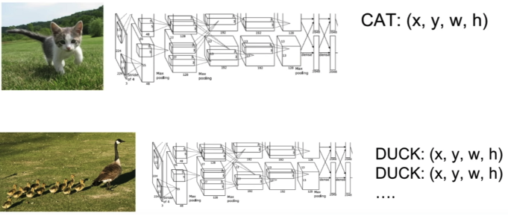
The major reason why we cannot proceed with this problem by building a standard convolutional network followed by a fully connected layer is that, the length of the output layer is variable—not constant, this is because the number of occurrences of the object of interest is not fixed. A naïve approach to solve this problem would be to take different regions of interest from the image, and use a CNN to classify the presence of the objects within that region.
The problem with this approach is that the objects of interest might have different spatial locations within the image and different aspect ratios.

Slide 5
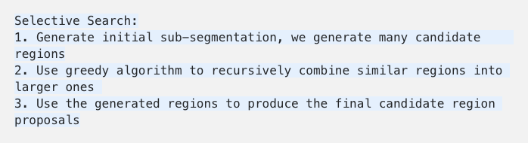
R-cnn
R-CNN extracts a bunch of regions from the given image using selective search, 2000 regions from the image, and then checks if any of these boxes contains an object.
These 2000 candidate region proposals are warped into a square and fed into a convolutional neural network that produces a 4096-dimensional feature vector as output.

Slide 6
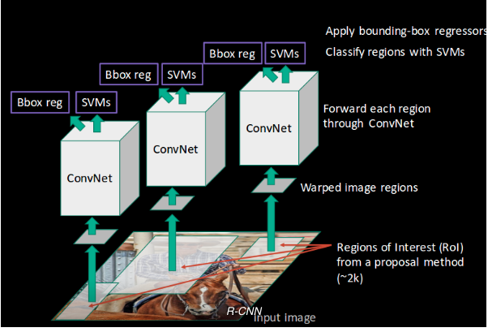
R-CNN
The CNN acts as a feature extractor and the output dense layer consists of the features extracted from the image and the extracted features are fed into an SVM to classify the presence of the object within that candidate region proposal.

Slide 7
Problems with R-CNN
1. It still takes a huge amount of time to train the network as we would have to classify 2000 region proposals per image.
2. It cannot be implemented real time as it takes around 47 seconds for each test image.
3. The selective search algorithm is a fixed algorithm. Therefore, no learning is happening at the stage. This could lead to the generation of bad candidate region proposals.

Slide 8
Fast R-CNN
The approach is similar to the R-CNN algorithm. But, instead of feeding the region proposals to the CNN, we feed the input image to the CNN to generate a convolutional feature map. From the convolution feature map, we identify the region of proposals and warp them into squares and by using a RoI pooling layer we reshape them into a fixed size so that it can be fed into a fully connected layer.
From the RoI feature vector, we use a softmax layer to predict the class of the proposed region and also the offset values for the bounding box.

Slide 9
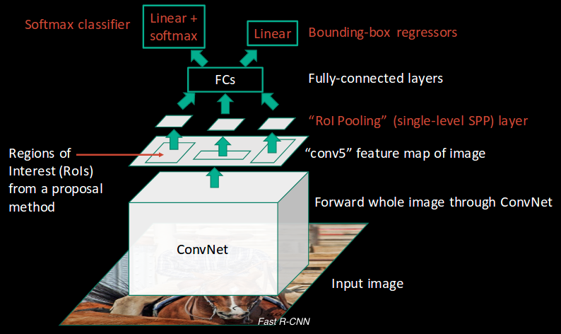
Fast R-CNN

Slide 10
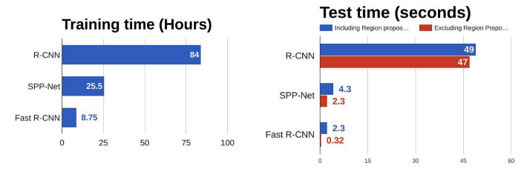
Fast R-CNN
The reason Fast R-CNN is faster than R-CNN is because you do not have to feed 2000 region proposals to the convolutional neural network every time. Instead, the convolution operation is done only once per image and a feature map is generated from it. All these steps are done simultaneously, thus, making it execute faster as compared to R-CNN
Notes:
From the above graphs, you can infer that Fast R-CNN is significantly faster in training and testing sessions over R-CNN.
When you look at the performance of Fast R-CNN during testing time, including region proposals shows down the algorithm significantly when compared to not using region proposals. Therefore, region proposals become bottlenecks in Fast R-CNN algorithm affecting its performance.

Slide 11
Faster R-CNN
Fast R-CNN is, however, not fast enough when applied on a large dataset as it also uses selective search for extracting the regions. Selective search(SS) is slow and time-consuming process affecting the performance of the network.
Similar to Fast R-CNN, the image is provided as an input to a convolutional network which provides as convolutional feature map. Instead of using SS algorithm on the feature map to identify the region proposals, a separate network, Region Proposal Network(RPN), is used to predict the region proposals. The predicted region proposals are then reshaped using a RoI pooling layer which is then used to classify the image within the proposed region and predict the offset values for the bounding boxes.

Slide 12
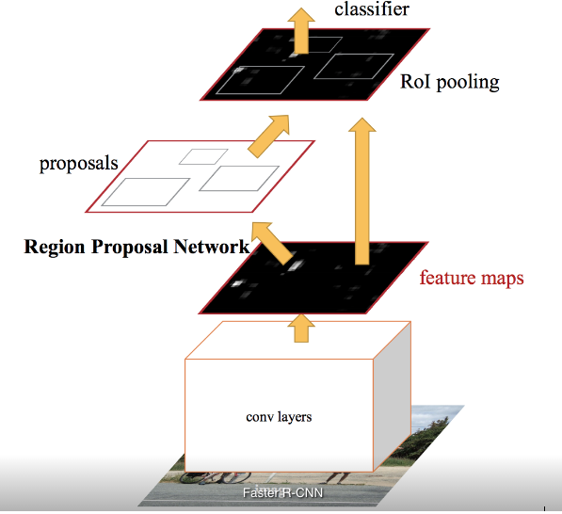
Faster R-CNN
Notes:
4 steps
Take an input image and pass it to the ConvNet which returns feature maps for the image
2.Apply RPN on these feature maps and get object proposals
3. Apply RoI pooling layer to bring down all the proposals to the same size
4. Pass these proposals to a fully connected layer in order to classify any predict the bounding boxes for the image

Slide 13
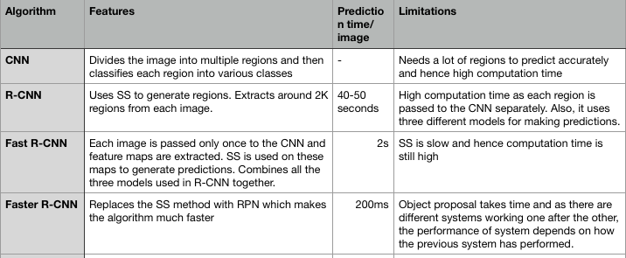
Comparison: R-CNN algorithm family

Slide 14
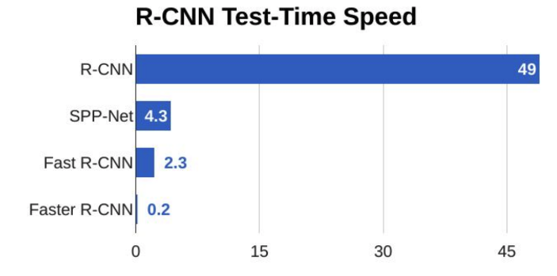
Comparison: R-CNN algorithm family
Notes:
From the above graph, you can see the faster R-CNN is much faster than its predecessors
Therefore, it can even be used for real-time object detection.

Slide 15
Region proposal methods
Region proposal methods typically rely on inexpensive features and economical inference schemes.
Selective Search, one of the most popular methods, greedily merges superpixels based on engineered low-level features. Yet when compared to efficient detection networks, SS is an order of magnitude slower at 2 seconds per image in a CPU implementation.
EdgeBoxes, currently provides the best tradeoff between proposal quality and speed, at 0.2 seconds per image. Nevertheless, the region proposal step still consumes as much running time as the detection network.
Region Proposal Network(RPN), that share convolutional layers with object detection network. By sharing convolutions at test-time, the marginal cost for computing proposal is small, 10ms per image.

Slide 16
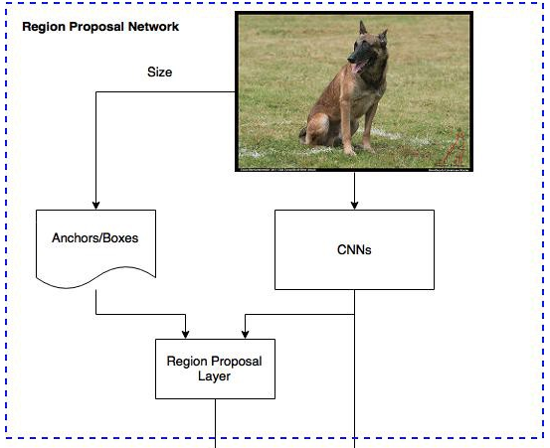
RPN

Slide 17
RPN
We construct an RPN by adding a few additional convolutional layers that simultaneously regress region bounds and objectness scores at each location on regular gird. RPN is a kind of fully convolutional network fro the task for generating detection proposals.
RPNs are designed to efficiently predict region proposals with a wide range of scales and aspect ratios. They have introduced the concept of anchors that serve as references at multiple scales and aspect ratios.
The scheme can be thought of as a pyramid of regression references which avoids enumerating images or filters of multiple scales or aspect ratios.
Notes:
1/ RPN takes an image (of any size) as input and outputs a set of rectangular object prposals, each with an objectness sore.
FCN, because their ultimate goal is to share computation with a Fast RCNN object detection network, they assume that both nets share a common set of convolutional layers.

Slide 18
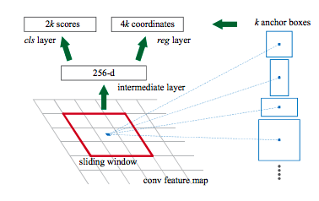
RPN
To generate region proposals, they slide a small network over the convolutional feature map output by the last shared convolutional layer. This small network takes as input an n * n spatial window of the input convolutional feature map. Each sliding window is mapped to a lower-dimensional feature.
This feature is fed into two sibling fully connected layers
A box-regression layer
A box–classification layer

Slide 19
RPN
Classifier determines the probability of a proposal having the target object.
Regression regresses the coordinates of the proposals.
For any image, scales and aspect-ration are two important parameters of the proposals.
The developers chose 3 scale and 3 aspect-ratio. So, total of 9 proposals are possible for each pixel, this is how the value of k is decided, K = 9 for this case.
For the whole image , number of anchors is W * H * K
Notes:
Aspect ratio = width of image/ height of image
Scales is the size of the image

Slide 20
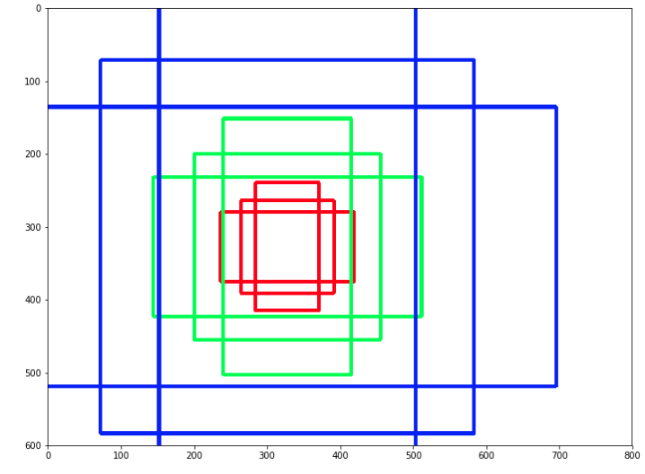
Anchors
1. Three colors represent
Three scales or sizes:
128*128, 256*256,512*512
2. Let’s single out the red
boxes/anchors. The three
boxes have height width
ratios 1:1,1:2, and 2:1
If we choose one position at every stride of 16, there will be 1989(29*51) positions. This leads to 17901(1989*9) boxes to consider. The sheer size is hardly smaller than the combination of sliding window and pyramid.
The bright side here is that we can use RPN to reduce number
Notes:
Anchors plays an important role in Faster R-CNN. An anchor is a box. In the default configuration of Faster R-CNN, there are 9 anchors at a position of an image.
The graph shows 9 anchors at the position (320,320) of an image with size (600,800)

Slide 21
Anchors
You have freedom to design different kinds of anchors/boxes.
For example, you are designing a network to count passengers/pedestrians, you may not need to consider the very short, very big, or square boxes. A neat set of anchors may increase the speed as well as the accuracy.
But how does it work?
These anchors are assigned label based on two factors:
The anchors with highest Intersection-over-union overlap with a ground truth box
The anchors with Intersection-over-union overlap higher than 0.7

Slide 22
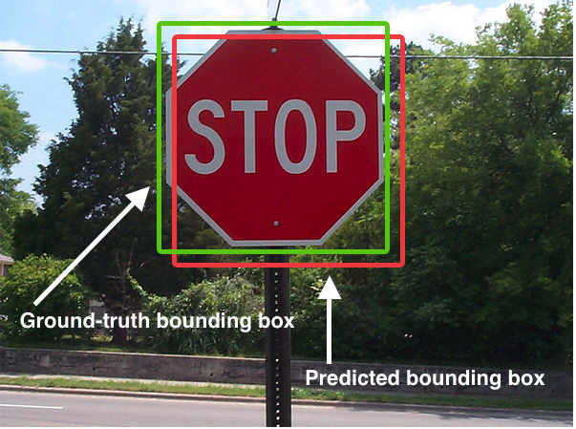
Intersection over union
An evaluation metric used to measure the accuracy of an detector on a particular dataset.
We need:
the ground-truth
bounding boxes
2. the predicted
bounding boxes
from our object

Slide 23
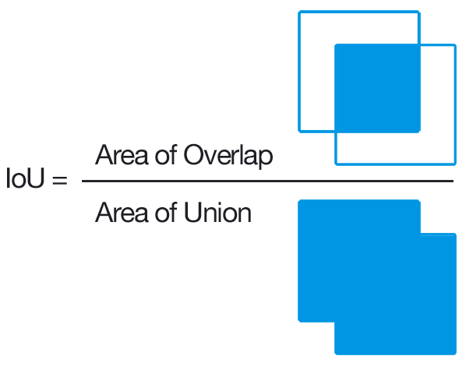
Intersection over union

Slide 24
The output of a RPN is a bunch of boxes/proposals that will be examined by a classifer and regressor to eventually check the occurrence of objects.
To be more precise, RPN
predicts the possibility of
an anchor being background
or foreground and refine the
anchor

Slide 25
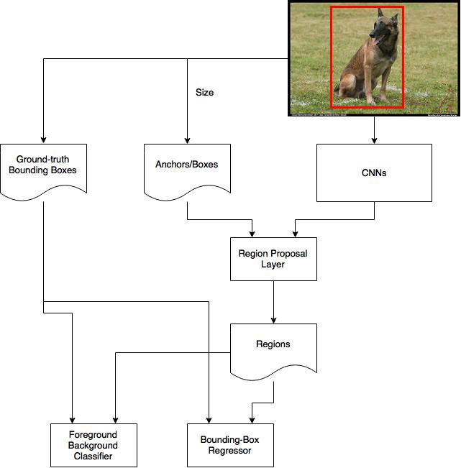

Slide 26
Background and foreground
The first step of training a classifier is make a training dataset. The training data is the anchors we get from the above process and the ground-truth boxes. The problem we need to solve here is how we use the ground-truth boxes to label the anchors.
The basic idea here is that we want to label the anchors having the higher overlaps with ground-truth boxes as foreground, the ones with lower overlaps as background.( paper: assign a binary class label of being an object or not to each anchor)

Slide 27
How does it work
For example:
Let’s say the 600*800 image shinks 16 times to a 39*51 feature map after applying CNNs.
Every position in the feature map has 9 anchors, and every anchor has two possible labels. If we make the depth of the feature map as 18 (9 anchors * 2 labels), we will make every anchor have a vector with two values (normally called logit) representing foreground and background.
If we feed the logit into a softmax/logistic regression activation function, it will predict the labels.
Hence, the training data is complete with features and labels.

Slide 28
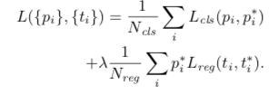
Loss function
Utimately, RPN is an algorithm that needs to be trained. So they definitely have loss function.
i: index of anchor p: probability of being an object or not
t: vector of 4 parameterized coordinates of predicted bounding box *: represents ground truth box
Lcls: is log loss over two classes Lreg: where R is the robust los function (smooth L1)
p*: with regression term in the loss function ensures that if and only if object is identified as yes, then only regression will count, otherwise p* will be zero, so the regression term will become zero in the loss function.
Ncls and Nreg are the normalization

Slide 29
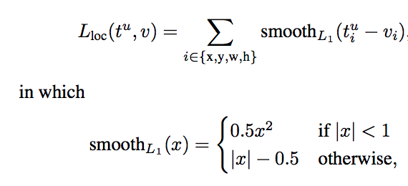
Regressor of bounding box
You can also pick out the anchors based on the similar criteria for the regressor to refine. One point here is that anchors labeled as background should not included in the regression, as we do not have ground-truth boxes for them. The depth of feature map is 32(9anchors * 4 positions)
The paper uses smooth-L1 loss on the position (x,y) of top-left the box, and the logarithm of the heights and widths, which is as the same as in Fast R-CNN

Slide 30
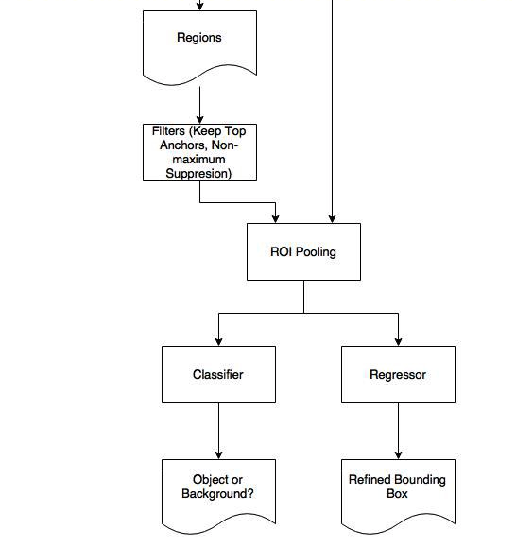
RoI pooling

Slide 31
Roi pooling
After RPN, we get proposed regions with different sizes. Different sized regions means different sized CNN feature maps.
It is not easy to make an efficient structure to work on features with different sizes.
Region of Interest Pooling can simplify the problem by reducing the feature maps into the same size.
Unlike Max-Pooling which has a fix size, ROI Pooling splits the input feature map into a fixed number(let’s say k) of roughly equal regions, and then apply Max-Pooling on every region.
Therefore the output of ROI Pooling is always k regardless the size of input

Slide 32
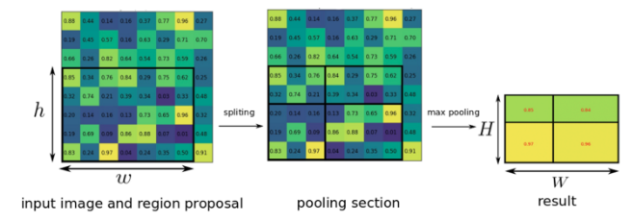
ROI pooling layer
For example:
Suppose we got the region proposal(left) with h*w, and we would like to have an output(right) of H*W sizes of output layer after pooling. Then the area for each pooling area(middle) = h/H*w/W.
In the example above, with intput ROI of 5*7, and output of 2*2, the area for each pooling area is 2*3 or 3*3 after rounding

Slide 33
Training RPNs
The paper mentioned three ways:
Alternating training: train RPN first and use the proposals to train Fast R-CNN. The network tuned by Fast R-CNN is then used to initialize RPN, and this process is iterated.
Approximate joint training: the RPN and Fast R-CNN network merged into one network during training. In each SGD iteration, the forward pass generates region proposals which are treated just like fixed, pre-computed proposals when training a Fast R-CNN detector. The backward propagation takes place as usual, where for the shared layers the backward propagated signals from both the RPN loss and the Fast R-CNN loss are combined.
Non-approximate joint training: the bouding boxes predicted by RRN are also functions of the input. The ROI pooling layer in Fast R-CNN accepts the convolutional feature and also the predicted boounding boxes as input, so a theoretically valid backpropataion slover should also involve gradients with respect to the box coordinates.
Notes:
2. Its easy but ignores the derivative with respect to the proposal boxes’ coordinates that are also network responses.
3. We need an ROI pooling layer that is differentiable with respect to the box coordinate

Slide 34
4-step alternating training
Train (fine-tune) RPN with imageNet pre-trained model
Train (fine-tune) a separate detection network with imageNet pre-trained model (convolutional layer not yet shared)
Use the detector network to initialize RPN training, fix the shared convolutional layers, only fine-tune unique layer of RPN
Keep the convolutional layers fixed, fine-tune the unique layers of detector network.
As such, both networks share the same convolutional layers and form a unified network

